Slide 1
ESc201 : Introduction to Electronics
Sequential Circuits
Vipul Arora
Dept. of Electrical Engineering
IIT Kanpur
April 10, 2023

Slide 2
Digital Circuits
Combinational Circuits
Sequential Circuits
Output is determined by current values of inputs only.
Output is determined by the current and past values of inputs/outputs.

Slide 3
Sequential Circuits
Time
The current state depends on previous states too
… if circuit has memory
E.g., Latch or Flip-flop: binary output

Slide 4
NOR SR Latch (Set-Reset Latch)
1
0
0
1
0
S R
Q Q
State
1 0
1 0
SET

Slide 5
NOR SR Latch
Reset
0
1
0
1
0
Set
S R
Q Q
State
1 0
1 0
SET
0 1
0 1
RESET

Slide 6
HOLD State
S R
Q Q
State
1
1
1 0
1 0
SET
0
0 0
1 0
HOLD
0 1
0 1
RESET
0
0 0
0 1
HOLD
0
0
S R
Q Q
State
1 0
1 0
SET
0 1
0 1
RESET
0 0
Q Q
HOLD
1 bit memory?
1 1
0 0
INVALID

Slide 7

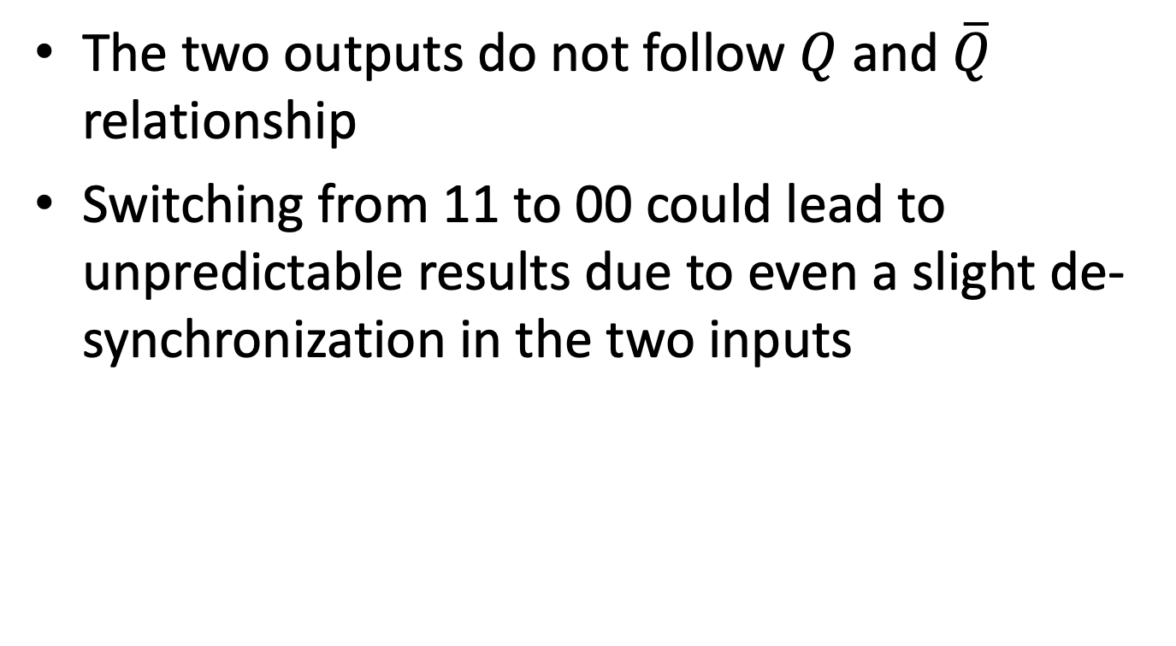
INVALID state
The two outputs do not follow $Q$ and $\overline{Q}$ relationship
Switching from 11 to 00 could lead to unpredictable results due to even a slight de-synchronization in the two inputs

Slide 8
1
0
Both the outputs are well defined and 0. The first problem is that we do not get complementary output.
1
0
A more serious problem occurs when we switch the latch to the hold state by changing RS from 11 → 00 . Suppose the inputs do not change simultaneously and we get the situation 11 → 01* → 00
1
0
1
0
0
1
0
0
1
1
0
0
Q = 1

Slide 9
1
0
1
0
0
1
0
0
1
1
0
0
Q = 1
Suppose the inputs change as RS = 11 → 10* → 00
1
1
0
0
0
0
1
1
1
0
0
0
Q = 0
So although output is well defined when we apply RS = 11, it becomes unpredictable once we switch the latch to hold state by applying RS = 00. That is why RS = 11 is not used as an input combination.

Slide 10
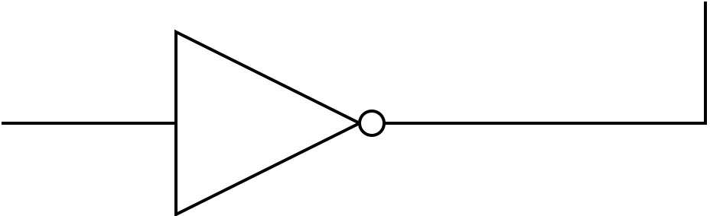
NAND Latch
S
R
S R
S R
Q Q
State
1 0
0 1
1 0
SET
0 1
1 0
0 1
RESET
0 0
1 1
Q Q
HOLD
1 1
0 0
1 1
INVALID

Slide 11
RS NAND Latch with Enable
1
Hold State
0
1
1

Slide 12
D latch
1
1
1
1
0
0
If EN = 1 then Q = D otherwise the latch is in Hold state

Slide 13
Latch with clock
A clock toggles periodically between 0 and 1
Discretizing the time
Edge triggered RS flip-flops
Edge triggered D flip-flops
Edge triggered JK flip-flops
clk
y
z
Circuits are designed with the idea there would be single change in output or memory state in single clock cycle.

Slide 14
Positive Edge Triggered Latch or Flip-flop
Time synchronization across a large system
Give sufficient time for info to be read
There are no commas in signal, so discrete time helps separate consecutive bits

Slide 15
Negative Edge Triggered Latch or Flip-flop

Slide 16
Master-Slave D Flip-flop
master
slave
The result is a negative edge triggered D Flip Flop
Master
Slave

Slide 17
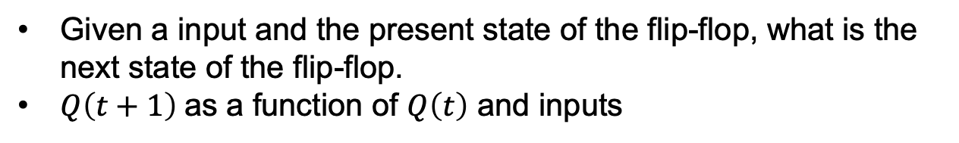
Characteristic table
Given a input and the present state of the flip-flop, what is the next state of the flip-flop.
$Q\left(t+1\right)$as a function of $Q\left(t\right)$ and inputs
(D)
0
0
1
1
Characteristic equation:

Slide 18
JK Flip-flop
J K
0 0
Q(t)
0 1
0
1 0
1
1 1
Q(t)
Characteristic equation:
JK flip flop is refinement of RS flip flop where
indeterminate state of RS flip flop is defined in JK Flip Flop

Slide 19
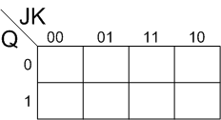
JK Flip-flop (characteristic equation)
Q(t) | J | K | Q(t+1)
0 | 0 | 0 | 0
0 | 0 | 1 | 0
0 | 1 | 0 | 1
0 | 1 | 1 | 1
1 | 0 | 0 | 1
1 | 0 | 1 | 0
1 | 1 | 0 | 1
1 | 1 | 1 | 0
1
1
1
1

Slide 20
Toggle or T Flip-flop
(T)
0
Q(t)
1
Q(t)
Characteristic equation:
T | Q(t) | Q(t+1)
0 | 0 | 0
0 | 1 | 1
1 | 0 | 1
1 | 1 | 0

Slide 21

Excitation Table
What inputs are required to effect a particular state change
Given $Q\left(t\right)$ and $Q\left(t+1\right)$, find inputs

Slide 22
Toggle or T Flip-flop
(T)
0
Q(t)
1
Q(t)
Characteristic equation:
Excitation Table
Excitation Table
Q | T | Q(t+1)
0 | 0 | 0
0 | 1 | 1
1 | 0 | 1
1 | 1 | 0
T
0
1
1
0

Slide 23
JK Flip-flop excitation table
J K
0 X
1 X
X 1
Characteristic Table
X 0
Excitation Table
Q | J | K | Q(t+1)
0 | 0 | 0 | 0
0 | 0 | 1 | 0
0 | 1 | 0 | 1
0 | 1 | 1 | 1
1 | 0 | 0 | 1
1 | 0 | 1 | 0
1 | 1 | 0 | 1
1 | 1 | 1 | 0

